Slide 1
IADS Summer School - Day 2
Anna Hughes & Alasdair Clarke 04/08/2022
1

Slide 2
Day 2 - the plan
Morning: Bayesian linear models - a recap and some practical experience
Afternoon: Going beyond linearity with Bayes
2

Slide 3
Getting set up to do Bayesian models

Slide 4
A quick reminder from yesterday
Bayesian statistics assumes that probability expresses the degree of belief in an event, and this may be based at least partly on our prior knowledge about the event.
This is different from frequentist statistics where probability is viewed as a limit of the relative frequency of an event after many trials.
The output from Bayesian and frequentists = may give you the same answers. Especially for simple models. The main difference is the underlying assumptions and how the answer is read exactly. However, Bayesian is much more stable for more complex models.
3

Slide 5
Bayesian models in R
We will be using the brms package to fit Bayesian models.
Hopefully everyone was able to get their computer set up okay to install all the dependencies needed, but shout now if not!
#install.packages("brms")
library(brms)
4

Slide 6
Bayesian linear models

Slide 7
Loading up some data
This is data on the height, weight and age from census data for the Dobe area !Kung San (a foraging population which has been extensively studied by anthropologists).
height_data <- read_csv('data/height.csv') %>% filter(age >= 18) # want to just use adults
glimpse(height_data)
| Read -> in data folder -> the Height file
| %>% A Forward-Pipe Operator |for R
|https://stackoverflow.com/questions/27125672/what-does-function-mean-in-r
## Rows: 352
## Columns: 4
## $ height <dbl> 151.7650, 139.7000, 136.5250, 156.8450, 145.4150, 163.8300, 149~
## $ weight <dbl> 47.82561, 36.48581, 31.86484, 53.04191, 41.27687, 62.99259, 38.~
## $ age <dbl> 63.0, 63.0, 65.0, 41.0, 51.0, 35.0, 32.0, 27.0, 19.0, 54.0, 47.~
## $ male <dbl> 1, 0, 0, 1, 0, 1, 0, 1, 0, 1, 0, 1, 0, 0, 0, 1, 1, 0, 1, 0, 1, ~

Slide 8
A (very) simple model
We want to ask: what is the mean height in this population?
What should our model look like?
We can define our heights as normally distributed, to give the likelihood*:
h_{i} ∼ Normal (µ, σ) What about our priors?
* The likelihood function is derived from a statistical model for the observed data - and the likelihood then tells us the compatability of the evidence with the given hypothesis.

Slide 9
A (very) simple model
We could set the prior for µ as follows:
µ ∼ Normal (178, 20)

Slide 10
Prior for µ
n <- 10000
mu_prior <- tibble(
sample = rnorm(n, mean = 178, sd = 20)
)
ggplot(mu_prior, aes(sample)) + geom_histogram(bins = 10)
3000
2000
1000
0
100 150 200 250
sample
count

Slide 11
A (very) simple model
We can define our heights as normally distributed, to give the likelihood*:
h_{i} ∼ Normal (µ, σ)
What about our priors? We could set the prior for µ as follows:
µ ∼ Normal (178, 20) And for σ:
σ ∼ Uniform(0, 50) = any number between the two values is equally likely
* The likelihood function is derived from a statistical model for the observed data - and the likelihood then tells us the compatability of the evidence with the given hypothesis.

Slide 12
Prior for σ
sigma_prior <- tibble(
sample = runif(n, min = 0, max = 50)
)
ggplot(sigma_prior, aes(sample)) + geom_area(stat="bin", bins=30)
400
300
200
100
0
0 10 20 30 40 50
sample
count

Slide 13
Prior for σ
A uniform prior has some desirable properties e.g. only positive values.
Unfortunately, it doesn’t tend to work very well for brms: maybe because the hard cut off doesn’t work well.
We therefore suggest using a half cauchy prior instead.

Slide 14
The half cauchy distribution
cauchy_prior <- tibble(
sample = rcauchy(n, location = 0, scale = 1)
)
# Only uses the positive real values (this is why it's called half-cauchy)
cauchy_prior <- filter(cauchy_prior, sample > 0)
ggplot(cauchy_prior, aes(sample)) + geom_density() + xlim(0,50)
0.5
0.4
0.3
0.2
0.1
0.0
0 10 20 30 40 50
sample
density
12

Slide 15
Exercise
Practice plotting these three distribution types (normal, half Cauchy, uniform) - try changing the values of the arguments and check you understand what happens.

Slide 16
Plotting heights
ggplot(height_data, aes(height)) + geom_histogram(bins=10)
60
count
40
20
0
140
150
160
height
170
180

Slide 17
Fitting the model: Markov chain Monte Carlo
To fit complex Bayesian models, we make use of Markov chain Monte Carlo (MCMC) techniques.
These don’t try to compute the posterior distribution directly - they instead draw millions of samples from the posterior, giving us a collection of parameter values that correspond to the frequencies of the posterior plausibilities. You can think of the technique as building a picture of the posterior from a histogram of the samples.

Slide 18
Fitting the model: linear models in R
1
0
−1
y
−1
0
1
x
Equation of a straight line: y = mx + c
Using R’s formula syntax, we write y ~ x
Here, we have only an intercept for now (i.e. y = c)
In R, we represent this with y ~ 1

Slide 19
Fitting the model with brm()
Model formula: see how this matches with the previous slide
Priors: these are also defined in our call - both what the prior will be, and its class (intercept or sigma)
Other arguments: the sampling process is repeated over 4 chains, each that run for 2000 iterations, half of which are warmup (they don’t get used in the analysis). Cores is the number of cores your computer will use (how hard it will work, basically) and seed acts like set.seed
height_model <-
brm(data = height_data, family = gaussian, height ~ 1,
prior = c(prior(normal(178,20), class = Intercept), prior(cauchy(0,1), class = sigma)),
iter = 2000, warmup = 1000, chains = 4, cores = 4,
seed = 4)
Warmup = aim for half of your iter.
chains = how many times computer will repeat the entire process (i.e., 4 times 2000 iter?)

Slide 20
Fitting the model with brm()
It is often good practice to pre-define your prior in a variable - makes you think about what your priors will be in advance!
height_model_prior <- c(prior(normal(178,20), class = Intercept),
prior(cauchy(0,1), class = sigma))
height_model <-
brm(data = height_data, family = gaussian, height ~ 1,
prior = height_model_prior,
iter = 2000, warmup = 1000, chains = 4, cores = 4,
seed = 4)

Slide 21
Fitting the model with brm()
If you are finding model fitting slow, you can often reduce the number of iterations (note that you generally want warmup to be around 50% of the total number of iterations).
height_model <-
brm(data = height_data, family = gaussian, height ~ 1,
prior = height_model_prior,
iter = 1000, warmup = 500, chains = 4, cores = 4,
seed = 4)

Slide 22
Fitting the model with brm()
summary(height_model)
## Family: gaussian
## Links: mu = identity; sigma = identity ## Formula: height ~ 1
## Data: height_data (Number of observations: 352)
## Draws: 4 chains, each with iter = 2000; warmup = 1000; thin = 1; ## total post-warmup draws = 4000
##
## Population-Level Effects:
## Estimate Est.Error l-95% CI u-95% CI Rhat Bulk_ESS Tail_ESS
## Intercept 154.60 0.42 153.76 155.41 1.00 ##
## Family Specific Parameters:
3454 2464
## Estimate Est.Error l-95% CI u-95% CI Rhat Bulk_ESS Tail_ESS ## sigma 7.74 0.28 7.19 8.32 1.00 3956 2623 ##
## Draws were sampled using sampling(NUTS). For each parameter, Bulk_ESS
## and Tail_ESS are effective sample size measures, and Rhat is the potential ## scale reduction factor on split chains (at convergence, Rhat = 1; if it is higher than 1.01, most likely something went wrong, check if your model specification makes sense, does your prior make sense, maybe up your iterations.).

Slide 23
What are these CIs?
Beware: CIs in the Bayesian context are credible intervals!
The proportion of MCMC draws for that particular parameter between the lower and upper CI bounds is equal to the specified probability (95% by default).

Slide 24
Summarising our model
It doesn’t make sense to use p values for for Bayesian models.
So we can just summarise our models in words using the
estimates and credible intervals e.g.
The estimate of mean height was 154.61cm (95% CI:
153.80-155.41cm). The estimate of the standard deviation around this mean height was 7.75cm (95% CI: 7.20-8.34cm)
You could even avoid the mean completely and just give the credible intervals! (Alasdair’s preferred method).

Slide 25
Checking that the model has fit properly
plot(height_model)
If all goes well, you should see a hair caterpillar.
b_Intercept
b_Intercept
0.75
0.50
0.25
0.00
156
155
154
Chain
1
2
3
4
154
155
0 200 400 600 8001000
sigma
sigma
1.5
1.0
0.5
0.0
9.0
8.5
8.0
7.5
7.0
7.0
7.5
8.0
8.5
0 200 400 600 8001000

Slide 26

What does a bad model fit look like?
What it looks like if it goes very fucking wrong
b_Intercept
b_Intercept
0.8
1.0
0.6
0.5
0.4
0.0
0.2
−0.5
−1.0
Chain
1
2
3
4
0.0
−1.0
−0.5
0.0
0.5
1.0
0
200
400
600
800
1000
40
sigma
sigma
50.00
30
49.95
20
49.90
10
0
49.85
49.85
49.90
49.95
0
200
400
600
800
1000

Slide 27
Summary of some terms so far
Parameter values are ways of indexing possible explanations of the data (e.g. possible heights).
A likelihood is a mathematical formula that specifies the plausibility of the observed data.
A prior is the initial plausibility assignment for each possible value of the parameter.
A posterior is the relative plausibility of different parameter values, conditional on the data.
Credible intervals tell us which parameter values lie at the bounds of a specified amount of posterior probability.

Slide 28
Adding a predictor
Let’s say we now want to ask if weight predicts height.
How would we formulate this model?
Can we be more specific about what we expect the effect to be?

Slide 29
Fitting the model
h_{i} ∼ Normal (µ_{i} , σ): family = gaussian
µ_{i} = α + βx_{i} : height ~ 1 + weight
α ∼ Normal (100, 20): prior(normal(100,20), class = intercept)
β ∼ Normal (0, 10): prior(normal(0,10), class = b)
σ ∼ Cauchy (0, 1): prior(cauchy(0,1), class = sigma)

Slide 30
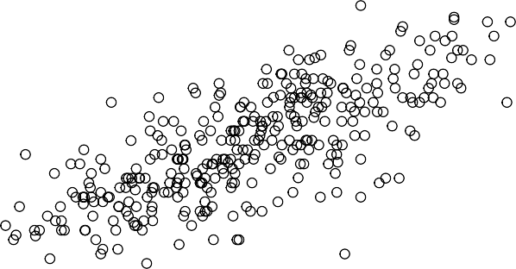
Looking at the data
ggplot(height_data, aes(weight, height)) + geom_point(shape = 1, size = 2) + theme_bw()
180
170
height
160
150
140
30
40
50
60
weight

Slide 31
Fitting the model
hw_model <-
brm(data = height_data, family = gaussian, height ~ 1 + weight,
prior = c(prior(normal(100,20), class = Intercept), prior(normal(0,10), class = b), prior(cauchy(0,1), class = sigma)),
iter = 2000, warmup = 1000, chains = 4, cores = 4,
seed = 4)

Slide 32
Checking that the model has fit properly
plot(hw_model)
b_Intercept
b_Intercept
0.2₁0₅
120
0.1₀0₅
115
0.00
110
110
114
118
0 200 400 600 8001000
Chain
₁
2
3
4
b_weight
b_weight
7₅.5₀
1.0
2.5
0.9
0.0
0.8
0.8
0.9
1.0
0 200 400 600 8001000
sigma
sigma
2₁.0₅
5.6₂
1₀.0₅
4.8₄
0.0
4.4 4.8
5.2
5.6
0 200 400 600 8001000

Slide 33
Summarising our model
Model here = can we predict height using people their weight. Says here -> a one unit increase in weight goes with ~ one unit increase in height. i.e., if you go up by 1kg, the model describes your height increases by 0.91cm.
summary(hw_model)
## Family: gaussian
## Links: mu = identity; sigma = identity ## Formula: height ~ 1 + weight
## Data: height_data (Number of observations: 352)
## Draws: 4 chains, each with iter = 2000; warmup = 1000; thin = 1; ## total post-warmup draws = 4000
##
## Population-Level Effects:
## Estimate Est.Error l-95% CI u-95% CI Rhat Bulk_ESS Tail_ESS
## Intercept | 113.81 | 1.94 109.92 117.70 1.00 | 4311 | 2927
## weight | 0.91 | 0.04 0.82 0.99 1.00 | 4299 | 3109
##
## Family Specific Parameters:
## Estimate Est.Error l-95% CI u-95% CI Rhat Bulk_ESS Tail_ESS ## sigma 5.09 0.19 4.71 5.48 1.00 3952 2532 ##
## Draws were sampled using sampling(NUTS). For each parameter, Bulk_ESS
## and Tail_ESS are effective sample size measures, and Rhat is the potential ## scale reduction factor on split chains (at convergence, Rhat = 1).

Slide 34
Plotting our model
We’re going to make use of some new packages to help us plot:
tidybayes and modelr.
library(tidybayes) library(modelr)

Slide 35
Plotting posterior inference against the data
First, we’re going to use a function called data_grid to help us generate an evenly spaced grid of points from the data.
height_data_posterior <- height_data %>% data_grid(weight = seq_range(weight, n = 51))
head(height_data_posterior)
## # A tibble: 6 x 1 ## weight
## | <dbl>
## 1 | 31.1
## 2 | 31.7
## 3 | 32.3
## 4 | 33.0
## 5 | 33.6
## 6 | 34.3

Slide 36
Plotting posterior inference against the data
We can use add_epred_draws which allows us to add a draw from the posterior predictions of the model (expectation of the posterior predictive) to each row of our data grid. (I’m then summarising to give a mean for each of the weights).
height_data_posterior <- height_data %>% data_grid(weight = seq_range(weight, n = 51)) %>% add_epred_draws(hw_model) %>%
group_by(weight) %>% summarise(mean_value = mean(.epred))
head(height_data_posterior)
## # A tibble: 6 x 2 ## weight mean_value
Draws randomly, but not really. It draws from the posterior = has a limited range + draws from probability distribution. So, the draw is random, but will still reflect where most of the probability weight is = around the mean.
## <dbl> | <dbl>
## 1 31.1 | 142.
## 2 31.7 | 143.
## 3 32.3 | 143.
## 4 33.0 | 144.
## 5 33.6 | 144.
## 6 34.3 | 145.

Slide 37
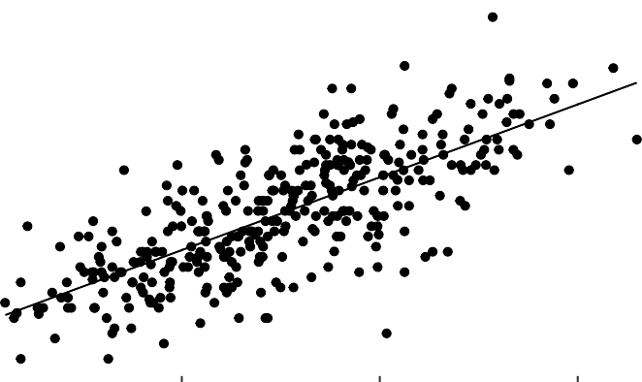
Plotting posterior inference against the data
ggplot(height_data_posterior, aes(x = weight, y = height)) + geom_line(aes(y = mean_value)) +
geom_point(data = height_data) + scale_fill_brewer(palette = "Greys") + scale_color_brewer(palette = "Set2")
180
170
160
150
140
height
30
40
50
60
weight
35

Slide 38
Adding uncertainty around the mean
Often we want to give an indication of uncertainty around the mean.
One way of doing this is to specify a number of draws (e.g. 50 in this example) and then plot each separately - this will give us a ‘spread’ of lines.
36

Slide 39
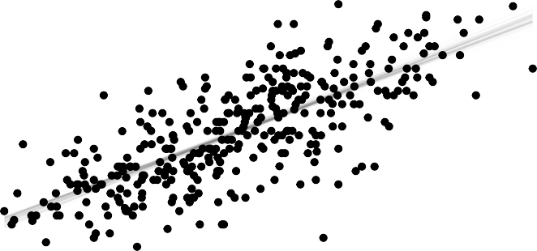
Adding uncertainty around the mean
height_data %>%
modelr::data_grid(weight = seq_range(weight, n = 51)) %>% add_epred_draws(hw_model, ndraws = 50) %>%
ggplot(aes(x = weight, y = height)) +
geom_line(aes(y = .epred, group = .draw), alpha = 0.05) + geom_point(data = height_data) + scale_color_brewer(palette = "Dark2")
180
Uncertainty = Variability = around the mean
NOT THE SAME as variability on a given trial OR between people (i.e., subject mean, i.e., the dots)
170
height
160
150
140
37
30
40
50
60

Slide 40
Plotting regression intervals
Another way of showing uncertainty around the mean is to plot regression intervals. We can use the stat_lineribbon argument to do this very easily!
height_data %>%
modelr::data_grid(weight = seq_range(weight, n = 51)) %>% add_epred_draws(hw_model) %>%
ggplot(aes(x = weight, y = height)) + stat_lineribbon(aes(y = .epred)) + geom_point(data = height_data) + scale_fill_brewer(palette = "Greys") + scale_color_brewer(palette = "Set2")

Slide 41
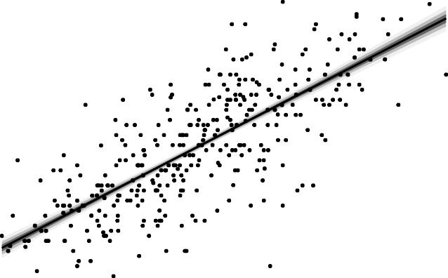
Plotting regression intervals
180
170
160
level
height
0.95
0.8
0.5
150
140
30
40
weight
50
60

Slide 42
Prediction intervals
Our full statistical model is:
h_{i} ∼ Normal (µ_{i} = α + βx, σ)
Using add_epred_draws only plots the µ part i.e. we are looking at the mean and the variability we expect in the mean. If we want to include the variability expressed by σ i.e. the variability we might expect on a trial-by-trial basis, we need to switch to using the add_predicted_draws function.

Slide 43
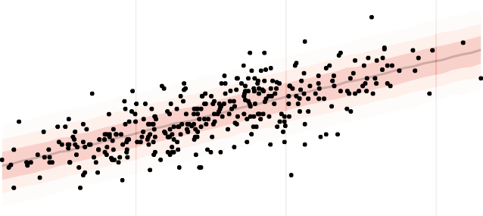
Prediction intervals
height_data %>%
modelr::data_grid(weight = seq_range(weight, n = 51)) %>% add_predicted_draws(hw_model) %>%
ggplot(aes(x = weight, y = height)) +
stat_lineribbon(aes(y = .prediction), .width = c(.95, .80, .50), alpha = 1/4) + geom_point(data = height_data) +
scale_fill_brewer(palette = "Reds") + scale_color_brewer(palette = "Reds") + theme_bw()
180
170
level
height
160
150
0.95
0.8
0.5
140
130
30
40
50
60
weight

Slide 44
Interim summary
In Bayesian modelling, we derive the posterior probability (distribution of parameter(s) after taking into account observed data) as a consequence of a prior probability and a likelihood function (derived from a statistical model for the observed data)
We can fit Bayesian models in R using brms
Trace plots should be used to check our models have fit correctly
We should aim to plot our posterior inferences, along with measures of uncertainty of these inferences such as regression or prediction intervals

Slide 45
Exercises
Have a go at Question 1 on the worksheet, which will check you’ve understood the principles we’ve discussed so far this morning.

Slide 46
Categorical data in Bayesian models

Slide 47
Categorical data
n <- 10
categorical_data <- tibble(
condition = rep(c("A","B","C","D","E"), n), response = rnorm(n * 5, c(0,1,2,1,-1), 0.5)
)

Slide 48
Categorical data - fitting a model
categorical_model <- brm( data = categorical_data, response ~ condition,
prior = c(prior(normal(0,1), class = Intercept), prior(normal(0,1), class = b), prior(cauchy(0,1), class = sigma)),
iter = 2000, warmup = 1000, chains = 4, cores = 4,
seed = 4)

Slide 49
Looking at our model
summary(categorical_model)
## Family: gaussian
## Links: mu = identity; sigma = identity ## Formula: response ~ condition
## Data: categorical_data (Number of observations: 50)
## Draws: 4 chains, each with iter = 2000; warmup = 1000; thin = 1; ## total post-warmup draws = 4000
##
## Population-Level Effects:
## Estimate Est.Error l-95% CI u-95% CI Rhat Bulk_ESS Tail_ESS
## Intercept | 0.06 | 0.17 | -0.26 | 0.40 1.00 | 2710 | 2360
## conditionB | 0.93 | 0.24 | 0.46 | 1.38 1.00 | 3066 | 3134
## conditionC | 2.12 | 0.23 | 1.65 | 2.58 1.00 | 3140 | 2848
## conditionD | 0.69 | 0.24 | 0.21 | 1.15 1.00 | 3026 | 2901
## conditionE | -0.94 | 0.23 | -1.38 | -0.49 1.00 | 3110 | 2818
##
## Family Specific Parameters:
## Estimate Est.Error l-95% CI u-95% CI Rhat Bulk_ESS Tail_ESS ## sigma 0.56 0.06 0.46 0.69 1.00 3595 3116 ##
## Draws were sampled using sampling(NUTS). For each parameter, Bulk_ESS
## and Tail_ESS are effective sample size measures, and Rhat is the potential ## scale reduction factor on split chains (at convergence, Rhat = 1).

Slide 50
Specifying priors more finely
Sometimes you might want to fit a prior on each level of the categorical variable individually. To see what your priors are, you can use the prior_summary function.
prior_summary(categorical_model)
##
prior
class
coef group resp dpar nlpar lb ub
source
## normal(0, 1) | b | user
## normal(0, 1) | b conditionB | (vectorized)
## normal(0, 1) | b conditionC | (vectorized)
## normal(0, 1) | b conditionD | (vectorized)
## normal(0, 1) | b conditionE | (vectorized)
## normal(0, 1) Intercept ## cauchy(0, 1) sigma |  | 0 | user user

Slide 51
Specifying priors more finely
categorical_model2 <- brm( data = categorical_data, response ~ condition,
prior = c(prior(normal(0,1), class = Intercept), prior(normal(0,1), class = b),
prior(normal(2,1), class = b, coef = "conditionD"), prior(cauchy(0,1), class = sigma)),
iter = 2000, warmup = 1000, chains = 4, cores = 4,
seed = 4)

Slide 52
Plotting your categorical results
As before, you can plot the fitted results e.g. the likely distribution of the mean values for each category.
categorical_data %>% modelr::data_grid(condition) %>% add_epred_draws(categorical_model) %>% ggplot(aes(x = .epred, y = condition)) + stat_slab()
E D C B A
−1 0 1 2 3 .epred
condition

Slide 53
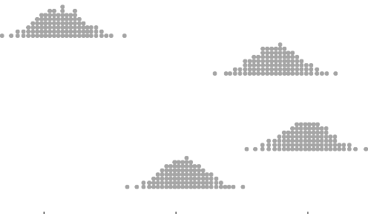
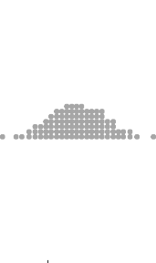
Plotting your categorical results
There are various options for displaying the distribution - you might prefer dots!
categorical_data %>% modelr::data_grid(condition) %>% add_epred_draws(categorical_model) %>% ggplot(aes(x = .epred, y = condition)) + stat_dots(quantiles = 100)
E D C B A
−1 0 1 2 .epred
condition

Slide 54
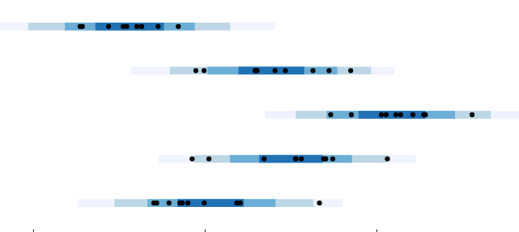
Plotting your categorical results
And you can also use predicted draws as well e.g. predicting the trial-by-trial variability rather than the variability in the mean.
categorical_data %>% modelr::data_grid(condition) %>% add_predicted_draws(categorical_model) %>% ggplot(aes(y = condition, x = .prediction)) +
stat_interval(.width = c(.50, .80, .95, .99)) + geom_point(aes(x = response), data = categorical_data) + scale_color_brewer()
E
D
level
condition
0.99
0.95
0.8
0.5
C
B
A
−2
0
.prediction
2
51

Slide 55
Exercises
Have a go at Questions 2 and 3 on the worksheet to practice
52

Slide 56
A more complex example

Slide 57
Questionnaire data
To what extent do religious beliefs predict opinions about whether the government should fund stem cell research?
1: definitely not fund
2: probably not fund
3: probably fund
4: definitely fund
This is an ordinal variable: we know that the categories have an order, but we don’t know what the psychological distance is between them (and whether that’s the same for all participants). We should account for this in our modelling!

Slide 58
Ordinal modelling: one approach
We can assume our observed ordinal variable Y originates from the categorisation of a latent continuous variable Y˜ .
Our model will assume there are K thresholds that partition Y˜ into
K + 1 observable, ordered categories of Y .
brms has glm functionality e.g. binomial, poisson. Here, we are using the cumulative(probit) family which corresponds to the situation above.

Slide 59
Modelling our prior
It’s sometimes difficult to work out how we should specify our priors, especially with new distributions. The sample_prior option allows us to just sample from the prior (no data is involved!) so we can tweak our prior distributions.
stemcell <- read_csv('data/stemcell.csv')
# Do some relevelling and reordering of our data
stemcell <- stemcell %>%
mutate(belief = fct_relevel(belief, "moderate", "liberal", "fundamentalist"), rating = abs(rating - 5))
# What should our priors be?
stemcell_model_prior <- brm( data = stemcell,
rating ~ 1 + belief,
family = cumulative("probit"),
prior = c(prior(normal(0,1), class = Intercept), prior(normal(0,1), class = b)),
sample_prior = "only", refresh = 0
)

Slide 60
Plotting our prior
stemcell %>% data_grid(belief) %>%
add_epred_draws(stemcell_model_prior) %>%
ggplot(aes(x = .category, y = .epred, color = belief)) + stat_pointinterval(.width = c(.5, .99), position = position_dodge(width = .4)) + scale_color_brewer(palette = "Accent") +
xlab('Score') + ylab('Probability') + theme_bw()
1.00
0.75
Probability
belief
0.50
moderate
liberal fundamentalist
0.25
0.00
1
2
Score
3
4

Slide 61
Can we improve our prior?
Perhaps we have some prior information about how different religious beliefs might affect our opinions of stem cell research funding.
stemcell_model_prior2 <- brm( data = stemcell,
rating ~ 1 + belief,
family = cumulative("probit"),
prior = c(prior(normal(0,1), class = Intercept),
prior(normal(0.5, 1), class = b, coef = "beliefliberal"), prior(normal(-0.5, 1), class = b, coef = "belieffundamentalist")),
sample_prior = "only"
)

Slide 62
Can we improve our prior?
stemcell %>% data_grid(belief) %>%
add_epred_draws(stemcell_model_prior2) %>%
ggplot(aes(x = .category, y = .epred, color = belief)) + stat_pointinterval(.width = c(.5, .99), position = position_dodge(width = .4)) + scale_color_brewer(palette = "Accent") +
xlab('Score') + ylab('Probability') + theme_bw()
1.00
0.75
Probability
belief
moderate liberal fundamentalist
0.50
0.25
0.00
1
2
Score
3
4

Slide 63
Fitting our model with the real data
stemcell_model<- brm( data = stemcell, rating ~ 1 + belief,
prior = c(prior(normal(0,1), class = Intercept),
prior(normal(0.5, 1), class = b, coef = "beliefliberal"), prior(normal(-0.5, 1), class = b, coef = "belieffundamentalist")),
family = cumulative("probit")
)

Slide 64
A summary of our model
summary(stemcell_model)
## Family: cumulative
## Links: mu = probit; disc = identity ## Formula: rating ~ 1 + belief
## Data: stemcell (Number of observations: 829)
## Draws: 4 chains, each with iter = 2000; warmup = 1000; thin = 1; ## total post-warmup draws = 4000
##
## Population-Level Effects:
## Estimate Est.Error l-95% CI u-95% CI Rhat Bulk_ESS
## Intercept[1] | -1.25 | 0.08 | -1.40 | -1.10 1.00 | 3062
## Intercept[2] | -0.63 | 0.07 | -0.77 | -0.50 1.00 | 3537
## Intercept[3] | 0.57 | 0.07 | 0.43 | 0.71 1.00 | 3346
## beliefliberal | 0.31 | 0.09 | 0.13 | 0.49 1.00 | 3410
## belieffundamentalist | -0.24 | 0.09 | -0.42 | -0.06 1.00 | 3398
## | Tail_ESS
## Intercept[1] | 2955
## Intercept[2] | 3169
## Intercept[3] | 3416
## beliefliberal | 3038
## belieffundamentalist 2908 ##
## Family Specific Parameters:
##
## disc ##
Estimate Est.Error l-95% CI u-95% CI Rhat Bulk_ESS Tail_ESS 1.00 0.00 1.00 1.00 NA NA NA
## Draws were sampled using sampling(NUTS). For each parameter, Bulk_ESS
## and Tail_ESS are effective sample size measures, and Rhat is the potential
60

Slide 65
Our fitted data - plotting
stemcell %>% data_grid(belief) %>%
add_epred_draws(stemcell_model) %>%
ggplot(aes(x = .category, y = .epred, color = belief)) + stat_pointinterval(.width = c(.5, .99), position = position_dodge(width = .4)) + scale_color_brewer(palette = "Accent") +
xlab('Score') + ylab('Probability') + theme_bw()
0.5
0.4
Probability
belief
moderate liberal fundamentalist
0.3
0.2
0.1
1
2
Score
3
4

Slide 66
Plotting our predicted data
predicted_data <- stemcell %>% modelr::data_grid(belief) %>% add_predicted_draws(stemcell_model, ndraws = 270) %>% group_by(belief, .prediction) %>%
summarise(count = n()) %>%
ggplot(aes(x = belief, y = count, fill = .prediction)) + geom_bar(position="stack", stat="identity") + coord_flip() +
scale_fill_brewer(palette="PRGn") + labs(fill = "Predicted value") + ggtitle("Predicted")
real_data <- stemcell %>% group_by(belief, rating) %>% summarise(count = n()) %>%
ggplot(aes(x = belief, y = count, fill = as.factor(rating))) + geom_bar(position="stack", stat="identity") +
coord_flip() + scale_fill_brewer(palette="PRGn") + labs(fill = "Real value") + ggtitle("Real data")

Slide 67
Putting everything together!
library(patchwork) predicted_data + real_data
Predicted
Real data
fundamentalist
fundamentalist
Predicted value
1
2
3
4
Real value
1
2
3
4
belief
liberal
belief
liberal
moderate
moderate
63
0
100
count
200
0
100
count
200
300

Slide 68
A little bit on model comparison

Slide 69
Model comparison philosophy
We may have several putative models that we want to be able to compare (competing hypotheses to explain our data).
Our question therefore becomes : which model is the most accurate? Which model should we use to draw conclusions?

Slide 70
Model comparison philosophy
Traditionally, we might use a measure such as R²: the model with the highest R² should have the best absolute fit to the data
But this model doesn’t necessarily perform the best on new data!
Ideally, we want to select the model that makes the best
predictions for data that hasn’t been observed

Slide 71
Model comparison philosophy
We don’t often have spare data lying around
Instead, we can use cross validation techniques in order to obtain an approximation of a model’s predictive abilities - two commonly used options are Bayesian leave-one-out cross validation (LOO-CV) and the Watanabe Akaike Information Criterion (WAIC)
Broadly, these two options are asymptomatically equivalent

Slide 72
Implementing model comparison with brms
Remembering our height-weight data from this morning: perhaps we have a hypothesis that age predicts height (remember we’ve restricted our data to adults only).
hwa_model <-
brm(data = height_data, family = gaussian, height ~ 1 + weight + age,
prior = c(prior(normal(100,20), class = Intercept), prior(normal(0,10), class = b), prior(cauchy(0,1), class = sigma)),
iter = 2000, warmup = 1000, chains = 4, cores = 4,
seed = 4)

Slide 73
Implementing model comparison with brms
First, we need to make sure our model fit criteria are included in our models. Here, we will use WAIC.
height_model <- add_criterion(height_model, "waic") hw_model <- add_criterion(hw_model, "waic") hwa_model <- add_criterion(hwa_model, "waic")

Slide 74
Implementing model comparison with brms
ELPD is the expected log predictive density: the top model in the output is always the ‘best’ model, and the rows below show how big the difference is between the other models and this best model.
loo_compare(height_model, hw_model, hwa_model, criterion = "waic")
## | elpd_diff | se_diff
## hw_model | 0.0 | 0.0
## hwa_model | -0.8 | 0.9
## height_model | -147.1 | 14.7

Slide 75
Interpreting elpd_diff
If elpd_diff is less than 4, the difference is small
If it is larger than 4, compare that difference to the standard error of elpd_diff: the difference should really be 4-5x bigger than the standard error difference to conclude that the models really are meaningfully different
In our example, we can see that including weight in our model is a big improvement on not having any predictors, but there’s not really any good evidence that adding age changes much either way

Slide 76
Summary and wrap up

Slide 77
Summary
The Bayesian framework can be extended to include non-linear models and multilevel models (and both at the same time!)
If you’re familiar with lme4, brms uses the same multilevel model syntax.
With more complex models, we can evaluate the posterior in a wider variety of ways - we need to think carefully about what questions we are trying to ask.

Slide 78
Problems?
There’s currently a bug lingering around somewhere in the Rstan ecosystem that causes the dreaded ‘R bomb’: you haven’t done anything wrong, this is a known current issue! Just restart your R (you shouldn’t lose any of your work)
If your models are failing to converge properly, consider whether you need to adjust your priors, or if more model iterations might help

Slide 79
Further reading
https://xcelab.net/rm/statistical-rethinking/ - the website for the Statistical Rethinking book, which is a great intro to Bayesian analysis if you’re interested in learning more about this topic.
https://github.com/rmcelreath/statrethinking_winter2019 - lecture slides and videos for the whole book.
https:
//bookdown.org/ajkurz/Statistical_Rethinking_recoded/ - the original Statistical Rethinking book uses slightly different code compared to what we’ve learned today. This website provides code translations into brms and the tidyverse.
https://avehtari.github.io/modelselection/CV-FAQ.html - lots of model selection advice.

Slide 80
Exercises
Have a go at Question 4 in the workbook to get some practice with a more complex dataset.
We are also here to help if you have any questions relating to your own data/models!

